Slide 1
Module 2 – Syntax Analysis
Bottom Up Parsing

Slide 2
Reductions
The process of “reducing" a string w to the start symbol of the grammar.
At each reduction step, a specific substring matching the body of a production is replaced by the nonterminal at the LHS/Head of that production.
The key decisions during bottom-up parsing are about when to reduce and about what production to apply, as the parse proceeds.
The reductions will be discussed in terms of the sequence of strings
id * id; F * id; T * id; T * F; T; E

Slide 3
Bottom-Up Parsing
A bottom-up parsing corresponds to the construction of a parse tree for an input string beginning at the leaves (the bottom) and working up towards the root (the top).
Ex: A bottom-up parse for id * id
Grammar:
E-->E + T | T
T-->T * F | F
F-->(E) | id

Slide 4
Parsing Methods
Parsing
Top down parsing
Bottom up parsing (Shift reduce)
Back tracking
Operator precedence
Parsing without backtracking (predictive Parsing)
LR parsing
SLR
LL(1)
CLR
Recursive
descent
LALR

Slide 5
Handle & Handle pruning
Handle: A “handle” of a string is a substring of the string that matches the right side of a production, and whose reduction to the non-terminal of the production is one step along the reverse of rightmost derivation.
Handle pruning: The process of discovering a handle and reducing it to appropriate left hand side non-terminal is known as handle pruning.
E→E+E
E→E*E
E→id
String: id1+id2*id3
Right sentential form | Handle | Production
Rightmost Derivation
E
E+E
E+E*E
E+E*id3
E+id2*id3
id1+id2*id3
id1+id2*id3 | id1 | E→id
E+id2*id3 | id2 | E→id
E+E*id3 | id3 | E→id
E+E*E | E*E | E→E*E
E+E | E+E | E→E+E
E

Slide 6
Shift reduce parser
The shift reduce parser performs following basic operations:
Shift: Moving of the symbols from input buffer onto the stack, this action is called shift.
Reduce: If handle appears on the top of the stack then reduction of it by appropriate rule/production is done. This action is called reduce action.
Accept: If stack contains start symbol only and input buffer is empty at the same time then that action is called accept action.
Error: A situation in which parser cannot either shift or reduce the symbols, it cannot even perform accept action then it is called error action.

Slide 7
Viable Prefix
The set of prefixes of right sentential forms that can appear on the stack of a shift-reduce parser are called viable prefixes.

Slide 8
Example: Shift reduce parser
Grammar:
E→E+T | T
T→T*F | F
F→id
String: id+id*id
Stack | Input Buffer | Action
$ | id+id*id$ | Shift
$id | +id*id$ | Reduce F→id
$F | +id*id$ | Reduce T→F
$T | +id*id$ | Reduce E→T
$E | +id*id$ | Shift
$E+ | id*id$ | Shift
$E+id | *id$ | Reduce F→id
$E+F | *id$ | Reduce T→F
$E+T | *id$ | Shift
$E+T* | id$ | Shift
$E+T*id | $ | Reduce F→id
$E+T*F | $ | Reduce T→T*F
$E+T | $ | Reduce E→E+T
$E | $ | Accept

Slide 9
Example 2
Consider the grammar
E –> 2E2
E –> 3E3
E –> 4
Perform Shift Reduce parsing for input string “32423”.

Slide 10
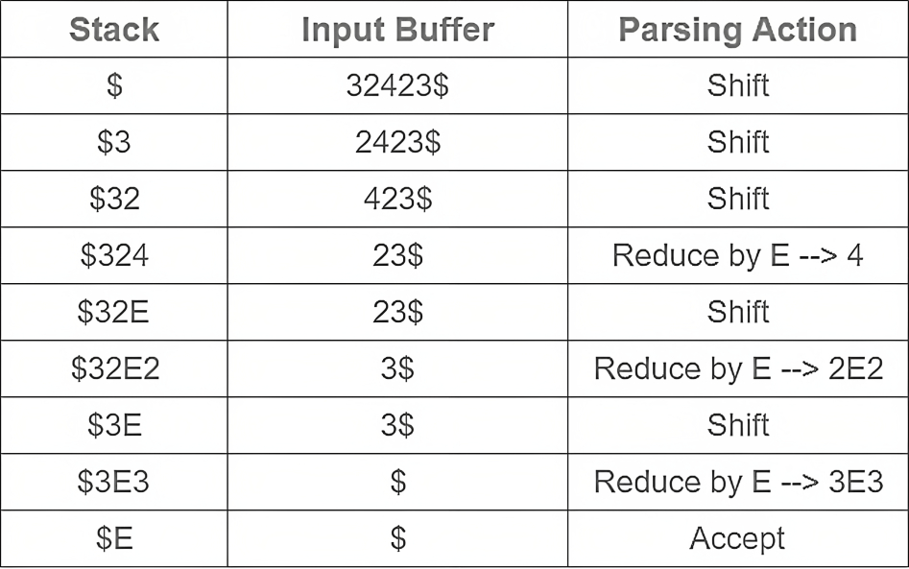
Example 2 - Solution

Slide 11
Example 3
Consider the grammar
S –> ( L ) | a
L –> L , S | S
Perform Shift Reduce parsing for input string “( a, ( a, a ) ) “.

Slide 12
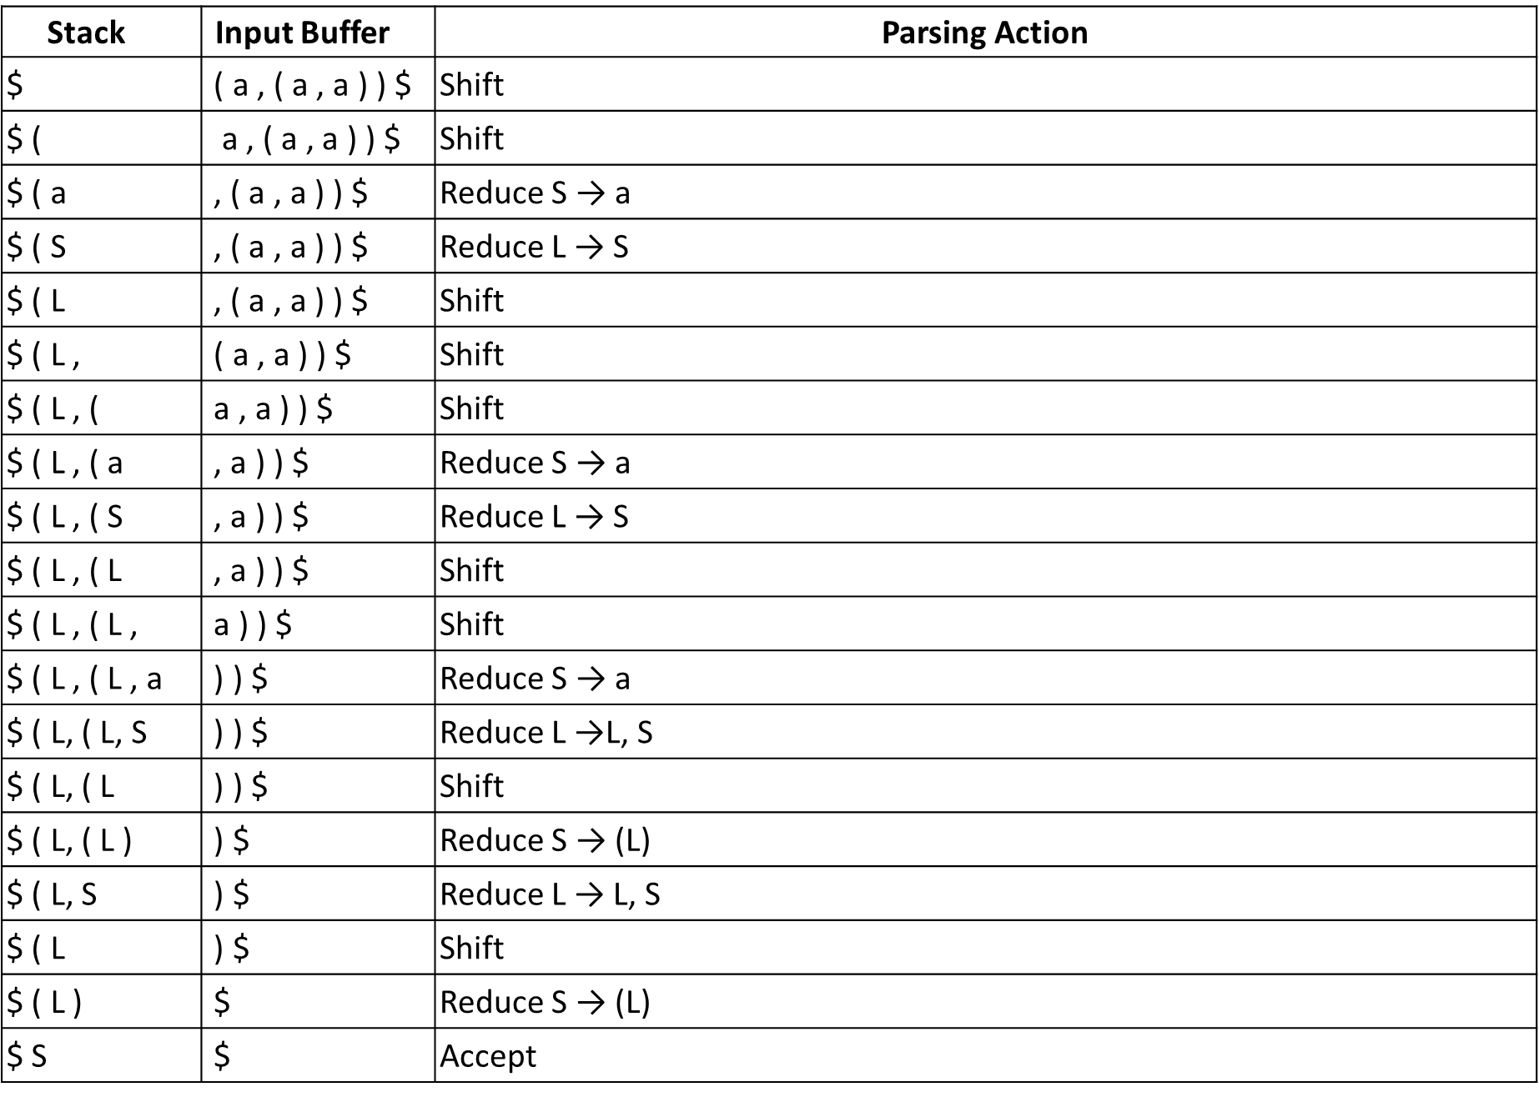
Example 3 - Solution

Slide 13
Parsing Methods
Parsing
Top down parsing
Bottom up parsing (Shift reduce)
Back tracking
Operator precedence
Parsing without backtracking (predictive Parsing)
LR parsing
SLR
LL(1)
CLR
Recursive
descent
LALR

Slide 14
Operator precedence parsing
An operator precedence parser is a bottom-up parser that interprets an operator grammar
Operator Grammar: A Grammar in which there is no Є in RHS of any production or no adjacent non-terminals is called operator grammar.
Example: E→ EAE | (E) | id
A→ + | * | -
Above grammar is not operator grammar because right side EAE has consecutive non terminals.
In operator precedence parsing we define following disjoint relations:
Relation | Meaning
a<.b | a “yields precedence to” b
a=b | a “has the same precedence as” b
a.>b | a “takes precedence over” b

Slide 15
Precedence & associativity of operators
Operator | Precedence | Associative
↑ | 1 | right
*, / | 2 | left
+, - | 3 | left

Slide 16
Steps of operator precedence parsing
Find Leading and trailing of non terminal
Establish relation and Creation of table
Parse the string

Slide 17
Leading & Trailing
Leading:- Leading of a non-terminal is the first terminal or operator in production of that non-terminal.
Trailing:- Trailing of a non-terminal is the last terminal or operator in production of that non-terminal.
Example 1: E→E+T | T
T→T*F | F
F→id
Rule:
If A→ αaβ and (α is a single variable or ε) then Leading (A) = a
If A→ Ba|β and β is a variable (NT) then Leading (A) = Leading (β)
Non terminal | Leading | Trailing
E | {+,*,id} | {+,*,id}
T | {*,id} | {*,id}
F | {id} | {id}

Slide 18
Leading & Trailing
Example 2: S-->a | ^ | (T)
T-->T,S | S
Rule:
If A→ αaβ and (α is a single variable or ε) then Leading (A) = a
If A→ Ba|β and β is a variable (NT) then Leading (A) = Leading (β)
Non terminal | Leading | Trailing
S | {a,^, (} | {a,^,)}
T | {,,a,^, (} | {,,a,^,)}

Slide 19

Rules to establish a relation
For a = b, $\text{⇒ }\text{aAb}$, where $\text{A}$ is $\text{ϵ}$ or a single non-terminal [e.g : (E)]
a <.b$\text{⇒}\text{T}\text{.}\text{NT} \text{then} \text{T}\text{ <. }\text{Leading}\left(\text{NT}\right)$ [e.g : +T]
a .>b$\text{⇒}\text{NT}\text{.}\text{T} \text{then} \left(\text{Trailing}\text{(}\text{NT}\right)\text{) }\text{.}\text{>}\text{T}$ [e.g : E+]
$ <. Leading (start symbol)
Trailing (start symbol) .> $

Slide 20

Example: Operator precedence parsing
a <.b
$Op .NT Op <. Leading\left(NT\right)$
$+T + <. \left\{∗,id\right\}$
$∗F ∗ <. \{id\}$
Step 1: Find Leading & Trailing of NT
E→ E
+T
| T
Nonterminal | Leading | Trailing
T→ T
| F
*F
E | {+,*,id} | {+,*,id}
F→ id
T | {*,id} | {*,id}
F | {id} | {id}
Step2(b): Creation of Table
Step 2 (a): Establish Relation
Step2(b): Creation of Table
Step 2 (a): Establish Relation
 | + | * | id | $
+ | .> | <. | <. | .>
* | .> | .> | <. | .>
id | .> | .> |  | .>
$ | <. | <. | <.

Slide 21

Example: Operator precedence parsing
a .>b
$NT . Op \left(Trailing(NT\right)).>Op$
$E+ \left\{+,∗,id\right\}.> +$
$T∗ \{∗,id\}.>∗$
Step 1: Find Leading & Trailing of NT
E→
E+
T| T
Nonterminal | Leading | Trailing
T→
F| F
T*
E | {+,*,id} | {+,*,id}
F→ id
T | {*,id} | {*,id}
F | {id} | {id}
Step 2 (a): Establish Relation
Step2(b): Creation of Table
 | + | * | id | $
+ | .> | <. | <. | .>
* | .> | .> | <. | .>
id | .> | .> |  | .>
$ | <. | <. | <.

Slide 22
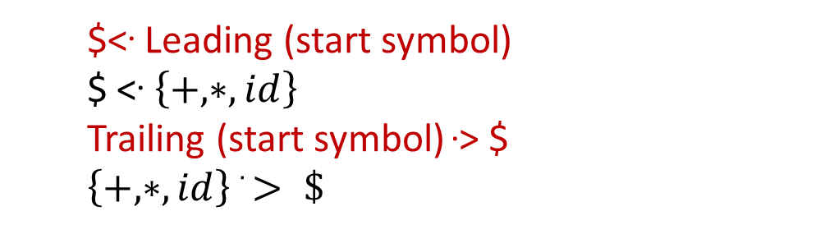
Example: Operator precedence parsing
Step 1: Find Leading & Trailing of NT
E→
E+
T| T
Nonterminal | Leading | Trailing
T→
F| F
T*
E | {+,*,id} | {+,*,id}
F→ id
T | {*,id} | {*,id}
F | {id} | {id}
Step 2 (a): Establish Relation
Step2(b): Creation of Table
 | + | * | id | $
$<. Leading (start symbol)
$ <. $\left\{+,∗,id\right\}$
Trailing (start symbol) .> $
$\left\{+,∗,id\right\} .> \$$
+ | .> | <. | <. | .>
* | .> | .> | <. | .>
id | .> | .> |  | .>
$ | <. | <. | <.
 |  |  |  | Accept

Slide 23
Example: Operator precedence parsing
Assign precedence operator between terminals
String: id+id*id
$ id+id*id $
$ <. id+id*id$
$ <. id .> +id*id$
$ <. id .> + <. id*id$
$ <. id .> + <. id .> *id$
$ <. id .> + <. id .> *<. id$
$ <. id .> + <. id .> *<. id .> $
Step 3(A): Parse the string using precedence table
 | + | * | id | $
+ | .> | <. | <. | .>
* | .> | .> | <. | .>
id | .> | .> |  | .>
$ | <. | <. | <.

Slide 24
Example: Operator precedence parsing
Step 3(B): Parse the string using precedence table
Scan the input string until first .> is encountered.
Scan backward until <. is encountered.
The handle is string between <. and .>
$ <. Id .> + <. Id .> * <. Id .> $ | Handle id is obtained between <. and .> Reduce this by F→id
$ F + <. Id .> * <. Id .> $ | Handle id is obtained between <. and .> Reduce this by F→id
$ F + F * <. Id .> $ | Handle id is obtained between <. and .> Reduce this by F→id
$ F + F * F $ | Perform appropriate reductions of all nonterminals.
$ E + T * F $ | Remove all non terminals.
$ + * $ | Place relation between operators
$ <. + <. * >$ | The * operator is surrounded by <. and .>. This indicates * becomes handle so reduce by T→T*F.
$ <. + >$ | + becomes handle. Hence reduce by E→E+T.
$ $ | Parsing Done

Slide 25
Example: Operator precedence parsing
Step 3: Parse the string using precedence table
 | + | * | id | $
+ | .> | <. | <. | .>
* | .> | .> | <. | .>
id | .> | .> |  | .>
$ | <. | <. | <.

Slide 26
Precedence function
Disadvantage of precedence table
If we have ‘n’ operators then size of table will be n*n and complexity will be O(n²).
In order to decrease the size of table, we use operator function table.
Precedence function
Used to store precedence relation into encoded form
Two functions ‘f’ and ‘g’ are used to map terminal symbols into integers
There exists symbols ‘f_{a}’ and ‘g_{a}’ for each terminal ‘a’
The precedence relations between the symbols are implemented by numerical comparison

Slide 27
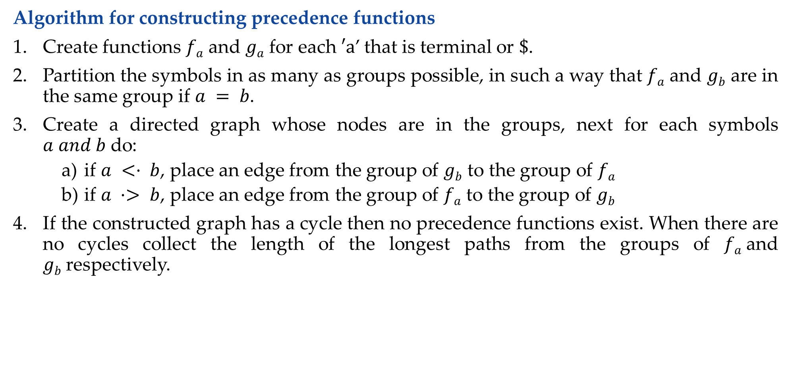
Operator precedence function
Algorithm for constructing precedence functions
Create functions $fa$ and $ga$ for each $′a$’ that is terminal or $\$$.
Partition the symbols in as many as groups possible, in such a way that $fa$ and $gb$ are in the same group if $a = b$.
Create a directed graph whose nodes are in the groups, next for each symbols $a and b$do:
if $a <· b$, place an edge from the group of $gb$ to the group of $fa$
if $a ·> b$, place an edge from the group of $fa$ to the group of $gb$
If the constructed graph has a cycle then no precedence functions exist. When there are no cycles collect the length of the longest paths from the groups of $fa$and $gb$respectively.

Slide 28

Operator precedence function
Create functions f_{a} and g_{a} for each a that is terminal or $.
$a= \{+,∗,id\} or \$$
E→ E+T | T
T→ T*F | F
F→ id
f₊
f*
f_{id}
f$
g₊
g*
g_{id}
g$

Slide 29
Operator precedence function
Partition the symbols in as many as groups possible, in such a way that f_{a} and g_{b} are in the same group if a = b.
.
 | + | * | id | $
g_{id}
f_{id}
+ | .> | <. | <. | .>
* | .> | .> | <. | .>
id | .> | .> |  | .>
$ | <. | <. | <.
f*
g*
g₊
f₊
f$
g$

Slide 30
Operator precedence function
if a <· b, place an edge from the group of g_{b} to the group of f_{a}
if a ·> b, place an edge from the group of f_{a} to the group of g_{b}
g
f
 | + | * | id | $
g_{id}
f_{id}
+ | .> | <. | <. | .>
* | .> | .> | <. | .>
id | .> | .> |  | .>
$ | <. | <. | <.
f*
g*
g₊
f₊
f₊ .> g₊
f₊-->g₊
f* .> g₊
f*-->g₊
f_{id} .> g₊
f_{id}-->g₊
f$
g$
f$ <. g₊
f$ ← g₊

Slide 31
Operator precedence function
if a <· b, place an edge from the group of g_{b} to the group of f_{a}
if a ·> b, place an edge from the group of f_{a} to the group of g_{b}
g
f
 | + | * | id | $
g_{id}
f_{id}
+ | .> | <. | <. | .>
* | .> | .> | <. | .>
id | .> | .> |  | .>
$ | <. | <. | <.
f*
g*
g₊
f₊
f₊ <. g*
f₊ ← g*
f* .> g*
f*-->g*
f_{id} .> g*
f_{id}-->g*
f$
g$
f$ <. g*
f$ ← g*

Slide 32
Operator precedence function
if a <· b, place an edge from the group of g_{b} to the group of f_{a}
if a ·> b, place an edge from the group of f_{a} to the group of g_{b}
g
f
 | + | * | id | $
g_{id}
f_{id}
+ | .> | <. | <. | .>
* | .> | .> | <. | .>
id | .> | .> |  | .>
$ | <. | <. | <.
f*
g*
g₊
f₊
f₊ <. g_{id}
f₊ ← g_{id}
f* <. g_{id}
f* ← g_{id}
f$ <. g_{id}
f$ ← g_{id}
f$
g$

Slide 33
Operator precedence function
if a <· b, place an edge from the group of g_{b} to the group of f_{a}
if a ·> b, place an edge from the group of f_{a} to the group of g_{b}
g
f
 | + | * | id | $
g_{id}
f_{id}
+ | .> | <. | <. | .>
* | .> | .> | <. | .>
id | .> | .> |  | .>
$ | <. | <. | <.
f*
g*
g₊
f₊
f₊ <. g$
f₊-->g$
f* <. g$
f*-->g$
f_{id} <. g$
f_{id}-->g$
f$
g$

Slide 34
Operator precedence function
 | + | * | id | $
f | 2
g_{id}
f_{id}
g
f*
g*
If the constructed graph has a cycle then no precedence functions exist. When there are no cycles collect the length of the longest paths from the groups of f_{a} and g_{b} respectively.
g₊
f₊
f$
g$

Slide 35
Operator precedence function
 | + | * | id | $
g_{id}
f_{id}
f | 2
g | 1
f*
g*
g₊
f₊
f$
g$

Slide 36
Operator precedence function
 | + | * | id | $
g_{id}
f_{id}
f | 2 | 4
g | 1
f*
g*
g₊
f₊
f$
g$

Slide 37
Operator precedence function
 | + | * | id | $
g_{id}
f_{id}
f | 2 | 4
g | 1 | 3
f*
g*
g₊
f₊
f$
g$

Slide 38
Operator precedence function
 | + | * | id | $
g_{id}
f_{id}
f | 2 | 4 | 4
g | 1 | 3
f*
g*
g₊
f₊
f$
g$

Slide 39
Operator precedence function
 | + | * | id | $
g_{id}
f_{id}
f | 2 | 4 | 4
g | 1 | 3 | 5
f*
g*
g₊
f₊
f$
g$

Slide 40
Operator precedence function
 | + | * | id | $
g_{id}
f_{id}
f | 2 | 4 | 4 | 0
g | 1 | 3 | 5 | 0
f*
g*
g₊
f₊
f$
g$
The complexity is reduced to O(2*n).

Slide 41
Example 2: Operator precedence parsing
Construct Precedence parsing table for the following grammar:
S-->a | ^ | (T)
T-->T,S | S
Soln:
Step 1: Find Leading & Trailing of NT
Non terminal | Leading | Trailing
S | {a,^, (} | {a,^,)}
T | {,,a,^, (} | {,,a,^,)}

Slide 42
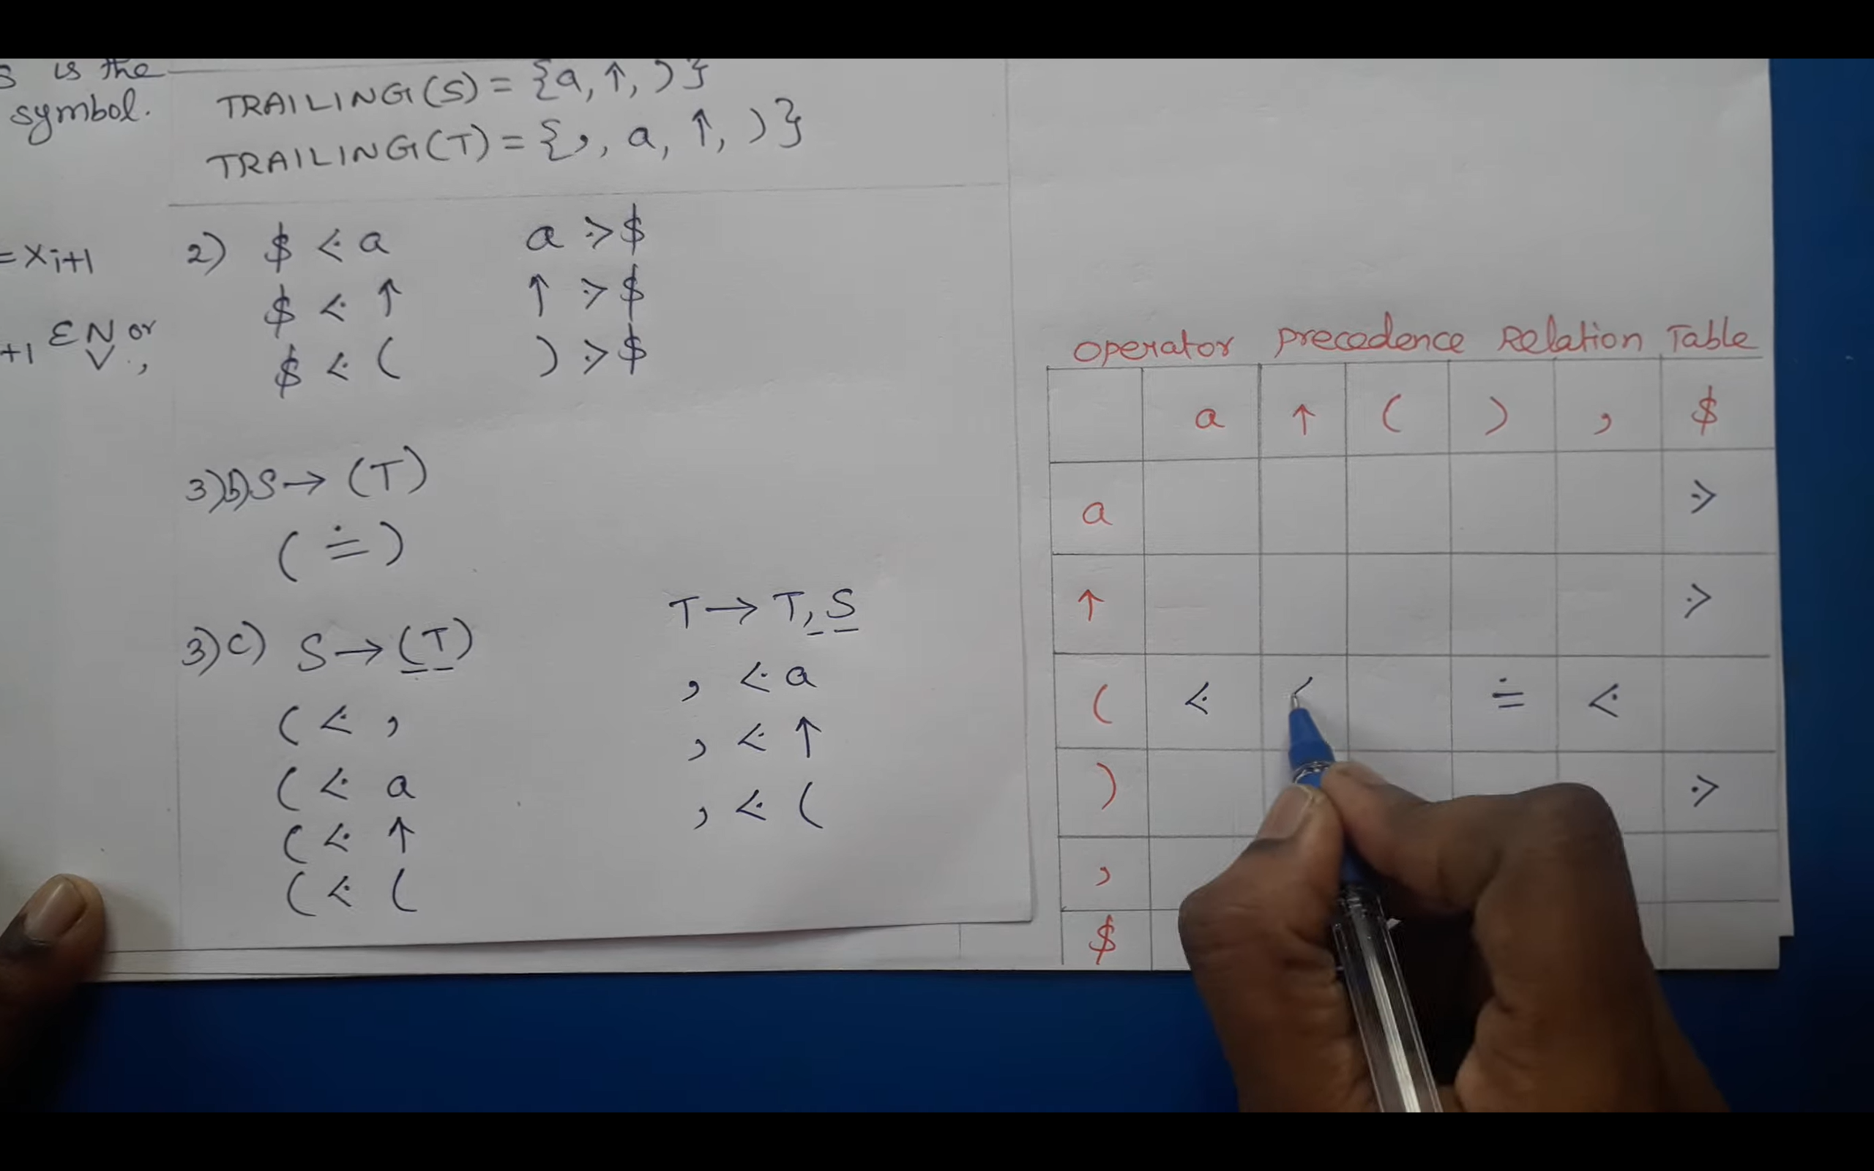
Example 2: Operator precedence parsing
S-->a | ^ | (T)
T-->T,S | S
Step 2(a): Establish Relation
Step 2(b): Creation of Table
 | a | ^ | ( | ) | , | $
a |  |  |  | .> | .> | .>
^ |  |  |  | .> | .> | .>
( | <. | <. | <. | = | <.
) |  |  |  | .> | .> | .>
, | <. | <. | <. | .> | .>
$ | <. | <. | <.

Slide 43
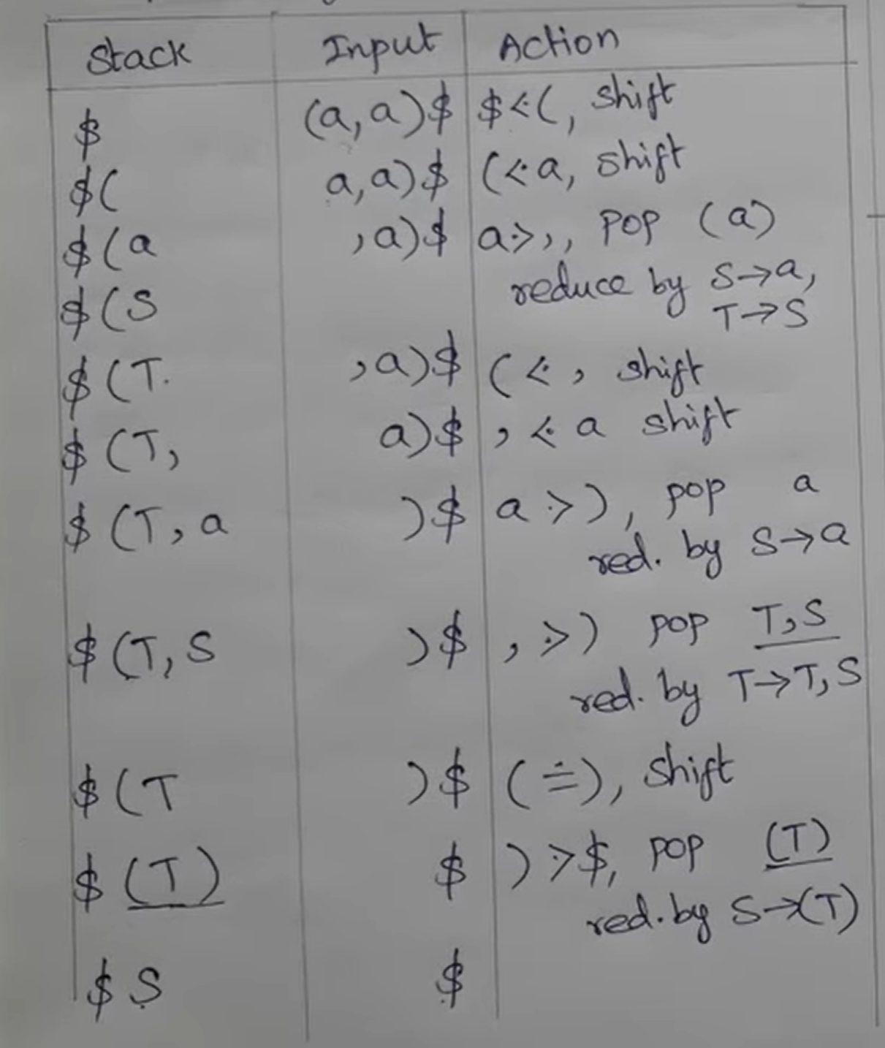
Example 2: Operator precedence parsing
Step 3: Parse the string using precedence table
 | a | ^ | ( | ) | , | $
a |  |  |  | .> | .> | .>
^ |  |  |  | .> | .> | .>
( | <. | <. | <. | = | <.
) |  |  |  | .> | .> | .>
, | <. | <. | <. | .> | .>
$ | <. | <. | <.

